Slide 1
SQL Joins Part 2

Slide 2
Types of Joins
Inner Join
Natural Join
Left (Outer) Join
Right (Outer) Join
)Full) Outer Join
Left (Outer) Join Excluding Inner Join
Right (Outer) Join Excluding Inner Join
(Full) Outer Join Excluding Inner Join
Cross Join

Slide 3
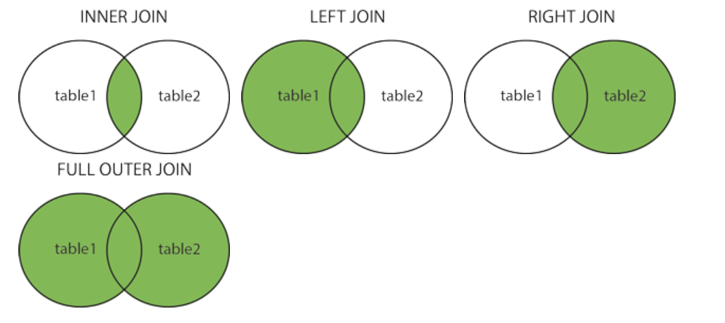
Different Types of SQL JOINs
Here are the different types of the JOINs in SQL:
(INNER) JOIN: Returns records that have matching values in both tables
LEFT (OUTER) JOIN: Returns all records from the left table, and the matched records from the right table
RIGHT (OUTER) JOIN: Returns all records from the right table, and the matched records from the left table
FULL (OUTER) JOIN: Returns all records when there is a match in either left or right table

Slide 4
Sample Tables
TableA
TableB
PK | Value
1 | FOX
2 | COP
3 | TAXI
6 | WASHINGTON
7 | DELL
5 | ARIZONA
4 | LINCOLN
10 | LUCENT
PK | Value
1 | TROT
2 | CAR
3 | CAB
6 | MONUMENT
7 | PC
8 | MICROSOFT
9 | APPLE
11 | SCOTCH

Slide 5
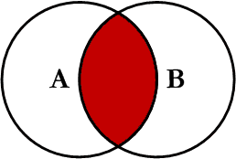
Inner Join
Inner join produces only the set of records that match in both Table A and Table B
Most commonly used, best understood join
Note:
Inner Joins do not have to use equality to join the fields
Can use <, >, <>
INNER JOIN Syntax
SELECT column_name(s) FROM table1 INNER JOIN table2 ON table1.column_name = table2.column_name;

Slide 6
Inner Join
TableA Value | PK | TableB PK | Value
FOX | 1 | 1 | TROT
COP | 2 | 2 | CAR
TAXI | 3 | 3 | CAB
WASHINGTON | 6 | 6 | MONUMENT
DELL | 7 | 7 | PC
SELECT *
FROM TableA INNER JOIN TableB
ON TableA.PK = TableB.PK;
This is the same as doing
SELECT *
FROM TableA, TableB
WHERE TableA.PK = TableB.PK;

Slide 7
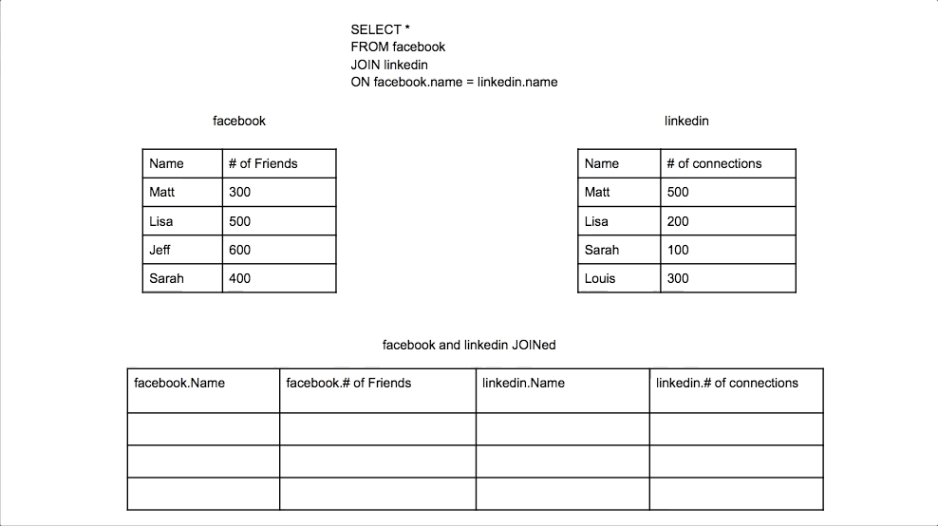

Slide 8
Inner Join (continued)
TableA PK | Value | TableB PK | Value
2 | COP | 1 | TROT
3 | TAXI | 1 | TROT
3 | TAXI | 2 | CAR
4 | LINCOLN | 1 | TROT
4 | LINCOLN | 2 | CAR
4 | LINCOLN | 3 | CAB
5 | ARIZONA | 1 | TROT
5 | ARIZONA | 2 | CAR
5 | ARIZONA | 3 | CAB
… | More… | Rows…
SELECT *
FROM TableA
INNER JOIN TableB
ON TableA.PK > TableB.PK;

Slide 9
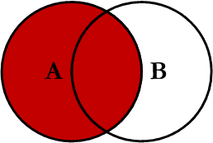
Left Outer Join
Left outer join produces a complete set of records from Table A, with the matching records (where available) in Table B. If there is no match, the right side will contain null.

Slide 10
Left Outer Join
TableA Value | PK | TableB PK | Value
FOX | 1 | 1 | TROT
COP | 2 | 2 | CAR
TAXI | 3 | 3 | CAB
LINCOLN | 4 | NULL | NULL
ARIZONA | 5 | NULL | NULL
WASHINGTON | 6 | 6 | MONUMENT
DELL | 7 | 7 | PC
LUCENT | 10 | NULL | NULL
SELECT *
FROM TableA LEFT OUTER JOIN TableB
ON TableA.PK = TableB.PK

Slide 11
SQL Joins…Example
SELECT S.name, E.classid
FROM Students S LEFT OUTER JOIN Enrolled E
ON S.sid=E.sid
S
S.name | S.sid
Jones | 11111
Smith | 22222
Brown | 33333
E
E.sid | E.classid
11111 | History105
11111 | DataScience194
22222 | French150
44444 | English10
S.name | E.classid
Jones | History105
Jones | DataScience194
Smith | French150
Brown | NULL
Notes:
Missing (unmatched) key values

Slide 12
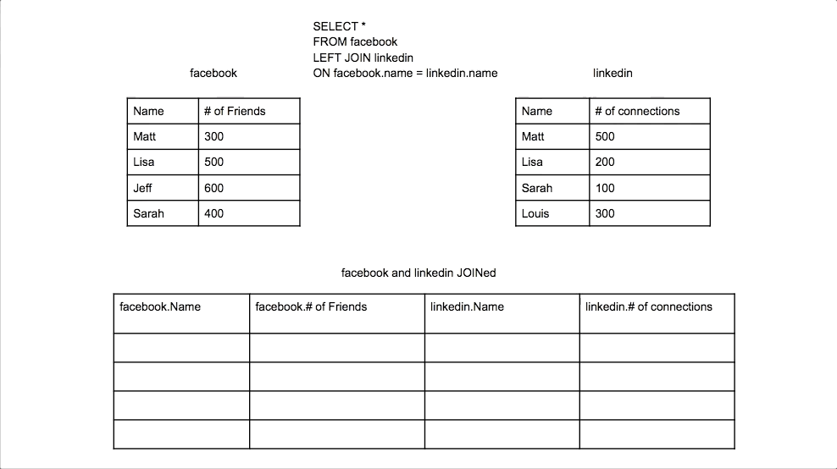

Slide 13
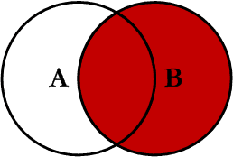
Right Outer Join
Right outer join produces a complete set of records from Table B, with the matching records (where available) in Table A. If there is no match, the left side will contain null.

Slide 14
Right Outer Join
Note: RIGHT are not currently supported
TableA Value | PK | TableB PK | Value
FOX | 1 | 1 | TROT
COP | 2 | 2 | CAR
TAXI | 3 | 3 | CAB
WASHINGTON | 6 | 6 | MONUMENT
DELL | 7 | 7 | PC
NULL | NULL | 8 | MICROSOFT
NULL | NULL | 9 | APPLE
NULL | NULL | 11 | SCOTCH
SELECT *
FROM TableA RIGHT OUTER JOIN TableB
ON TableA.PK = TableB.PK

Slide 15
SQL Joins…..example
SELECT S.name, E.classid
FROM Students S RIGHT OUTER JOIN Enrolled E
ON S.sid=E.sid
S
S.name | S.sid
Jones | 11111
Smith | 22222
Brown | 33333
E
E.sid | E.classid
11111 | History105
11111 | DataScience194
22222 | French150
44444 | English10
S.name | E.classid
Jones | History105
Jones | DataScience194
Smith | French150
NULL | English10
Notes:
Missing (unmatched) key values

Slide 16


Slide 17
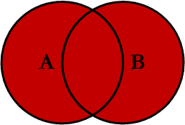
Full Outer Join
Full outer join produces the set of all records in Table A and Table B, with matching records from both sides where available. If there is no match, the missing side will contain null.

Slide 18
Full Outer Join
TableA Value | PK | TableB PK | Value
FOX | 1 | 1 | TROT
COP | 2 | 2 | CAR
TAXI | 3 | 3 | CAB
LINCOLN | 4 | NULL | NULL
ARIZONA | 5 | NULL | NULL
WASHINGTON | 6 | 6 | MONUMENT
DELL | 7 | 7 | PC
LUCENT | 10 | NULL | NULL
NULL | NULL | 8 | MICROSOFT
NULL | NULL | 9 | APPLE
NULL | NULL | 11 | SCOTCH
SELECT * FROM TableA FULL OUTER JOIN TableB ON TableA.PK
= TableB.PK

Slide 19
SQL Joins….. Example
SELECT S.name, E.classid
FROM Students S FULL OUTER JOIN Enrolled E
ON S.sid=E.sid
S
S.name | S.sid
Jones | 11111
Smith | 22222
Brown | 33333
E
E.sid | E.classid
11111 | History105
11111 | DataScience194
22222 | French150
44444 | English10
S.name | E.classid
Jones | History105
Jones | DataScience194
Smith | French150
NULL | English10
Brown | NULL
Notes:
Missing (unmatched) key values

Slide 20


Slide 21
Cross Join
A cross join is a Cartesian Product join – it is every record in Table A combined with every record in Table B.
It gives the same results as not using a WHERE clause when querying two tables in MySQL
SELECT * from TableA CROSS JOIN TableB
SELECT * from TableA, TableB

Slide 22
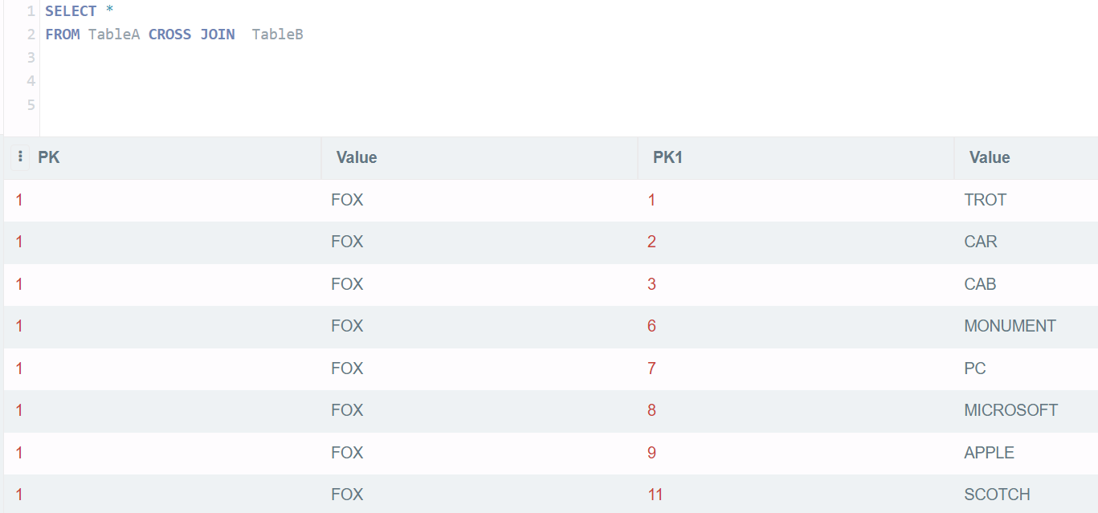
Cross Join

Slide 23
SQL Joins
SELECT *
FROM Students S CROSS JOIN Enrolled E
S
S.name | S.sid
Jones | 11111
Smith | 22222
E
E.sid | E.classid
11111 | History105
11111 | DataScience194
22222 | French150
S.name | S.sid | E.sid | E.classid
Jones | 11111 | 11111 | History105
Jones | 11111 | 11111 | DataScience194
Jones | 11111 | 22222 | French150
Smith | 22222 | 11111 | History105
Smith | 22222 | 11111 | DataScience194
Smith | 22222 | 22222 | French150

Slide 24
Theta Joins
SELECT *
FROM Students S, Enrolled E
WHERE S.sid <= E.sid
S
S.name | S.sid
Jones | 11111
Smith | 22222
E
E.sid | E.classid
11111 | History105
11111 | DataScience194
22222 | French150
S.name | S.sid | E.sid | E.classid
Jones | 11111 | 11111 | History105
Jones | 11111 | 11111 | DataScience194
Jones | 11111 | 22222 | French150
Smith | 22222 | 22222 | French150

Slide 25
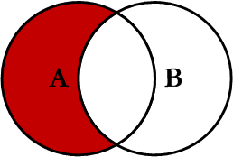
Left Join Excluding Inner Join
This query will return all of the records in the left table (table A) that do not match any records in the right table (table B).

Slide 26
Left Join Excluding Inner Join
TableA Value | PK | TableB PK | Value
LINCOLN | 4 | NULL | NULL
ARIZONA | 5 | NULL | NULL
LUCENT | 10 | NULL | NULL
SELECT * FROM TableA LEFT JOIN TableB
ON TableA.PK = TableB.PK
WHERE TableB.PK IS NULL;
Perform left outer join, then exclude the records we don't want from the right side via a where clause.

Slide 27
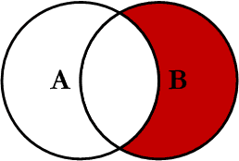
Right Join Excluding Inner Join
This query will return all of the records in the right table (table B) that do not match any records in the left table (table A).

Slide 28
Right Join Excluding Inner Join
TableA Value | PK | TableB PK | Value
NULL | NULL | 8 | MICROSOFT
NULL | NULL | 9 | APPLE
NULL | NULL | 11 | SCOTCH
SELECT * FROM TableA RIGHT JOIN TableB
ON TableA.PK = TableB.PK
WHERE TableA.PK IS NULL
Perform right outer join, then exclude the records we don't want from the left side via a where clause.

Slide 29
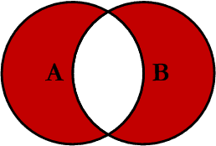
Full Outer Excluding Inner Join
This query will return all of the records in Table A and Table B that do not have a matching record in the other table.
In general, Not used

Slide 30
Full Outer Excluding Inner Join
TableA Value | PK | TableB PK | Value
NULL | NULL | 8 | MICROSOFT
NULL | NULL | 9 | APPLE
NULL | NULL | 11 | SCOTCH
LINCOLN | 4 | NULL | NULL
ARIZONA | 5 | NULL | NULL
LUCENT | 10 | NULL | NULL
SELECT * FROM TableA FULL OUTER JOIN TableB
ON TableA.PK = TableB.PK
WHERE TableA.PK IS NULL OR TableB.PK IS NULL

Slide 31
Students and Faculty
student_id | student_name | course_id | course_name | faculty_id | faculty_name | salary
101 | Rahul | C01 | DBMS | F01 | Dr. Verma | 70000
102 | Priya | C01 | DBMS | F01 | Dr. Verma | 70000
103 | Ankit | C02 | Java | F02 | Ms. Neha | 65000
104 | Sita | C02 | Java | F02 | Ms. Neha | 65000
105 | Aman | C03 | Python | F03 | Mr. Kumar | 60000
106 | Deepak | C03 | Python | F03 | Mr. Kumar | 60000
107 | Meena | C01 | DBMS | F01 | Dr. Verma | 70000
108 | Karan | C02 | Java | F02 | Ms. Neha | 65000
109 | Simran | C04 | C++ | F04 | Dr. Arjun | 72000
110 | Riya | C04 | C++ | F04 | Dr. Arjun | 72000

Slide 32
Anomalies Students and Faculty table Can Cause:
1. Insert Anomaly
If we want to add a new course and its faculty but no student has enrolled yet, we can't insert it.
Example: Can’t insert course C05, "AI", with faculty F05 until a student takes it.
2. Update Anomaly
If we update Dr. Verma’s salary in one row but forget to update it in all rows → data mismatch.
3. Delete Anomaly
If the last student in course C03 (Python) is deleted, all data about that course and faculty is lost.
To avoid anomalies:
Break into 3 tables:
students(student_id, student_name)
courses(course_id, course_name, faculty_id)
faculty(faculty_id, faculty_name, salary)
And use foreign keys

Slide 33
Understanding Indexing in MySQL
An index in MySQL is a data structure that improves the speed of data retrieval operations on a database table.
Think of it like a book index – instead of reading every page, you go directly to the topic.
Why Use Indexing?
Faster SELECT queries Efficient data search Reduced data scanning
But: Slows down INSERT, UPDATE, DELETE Takes extra disk space

Slide 34
Basic Syntax of Index
Create index on existing table:
CREATE INDEX index_name ON table_name (column_name);
Drop index:
DROP INDEX index_name ON table_name;
Example Without Index
CREATE TABLE students ( id INT, name VARCHAR(100), age INT );
Query without index:
SELECT * FROM students WHERE name = 'Amit';
This does full table scan
Example With Index
Add index:
CREATE INDEX idx_name ON students(name);
Now the query:
SELECT * FROM students WHERE name = 'Amit';
Uses index lookup → Faster!

Slide 35
Composite Index Example
CREATE INDEX idx_name_age ON students(name, age);
Optimized for queries like:
SELECT * FROM students WHERE name='Amit' AND age=20;
When Not to Use Index
On small tables On columns with many duplicates If table updates are frequent

Slide 36
Indexing Demonstration Activity: "Speed Up the Search"
Goal:Show that searching *with an index* is much faster than *without an index*
CREATE TABLE people
( id INT AUTO_INCREMENT PRIMARY KEY,
name VARCHAR(100),
email VARCHAR(100),
phone VARCHAR(20)
);
DELIMITER //CREATE PROCEDURE populate_people()BEGIN DECLARE i INT DEFAULT 1; WHILE i <= 1000000 DO INSERT INTO people (name, email, phone) VALUES ( CONCAT('Person_', i), CONCAT('person', i, '@example.com'), CONCAT('12345', LPAD(i, 5, '0')) ); SET i = i + 1; END WHILE;END;//DELIMITER ;-- Run the procedureCALL populate_people();
Step 3: Run Search Without Index#### Find a record:sql-- Start timerSELECT NOW();-- Execute slow querySELECT * FROM people WHERE email = 'person999999@example.com';-- End timerSELECT NOW();

